Slide 1

Future Skills Program of Pradhan Mantri Kaushal Vikas Yojana 4.0 (PMKVY)
Course Name: Artificial Intelligence and Big Data Analytics
Course Duration: - 4 Months
On-Job-Training Report
On
Heart Disease Prediction
Submitted By:
Student Name: Vivek Sharma Candidate ID: CAN_26562312
Student Name: Sahil Rana Candidate ID: CAN_26626698
Student Name: Mansi Candidate ID: CAN_26654395
Future Skills 4.0
in collaboration with IBM, NSDC and Lamrin Tech Skills University Punjab.
(2023-24)

Slide 2
Heart Disease Prediction

Slide 3
TABLE OF CONTENTS
01
04
02
05
03
Problem Statement
Demo of the Project
Solution
Conclusion
Implementation

Slide 4
INTRODUCTION
Heart disease is a leading cause of mortality worldwide, emphasizing the critical need for early detection and prevention strategies. Our project focuses on leveraging machine learning techniques to predict the likelihood of heart disease in individuals based on various health and lifestyle factors.

Slide 5
01
Problem Statement
To develop a machine learning model that accurately predicts the likelihood of heart disease in individuals based on their health and lifestyle factors, including age, sex, blood pressure, and cholesterol levels. This model will assist healthcare providers in identifying at-risk individuals early, enabling targeted interventions and personalized healthcare approaches to reduce the incidence and impact of heart disease.

Slide 6
02
Solution
Objective: Develop a machine learning model to predict heart disease risk based on individual health data.
Approach:
Data Collection: Gather a dataset with key features such as age, sex, blood pressure, and cholesterol levels.
Data Preprocessing: Clean and prepare the data for analysis.
Model Development: Build a machine learning model to predict heart disease risk.
Model Evaluation: Assess the model's performance using standard metrics like accuracy and recall.
Outcome:
A predictive model that can accurately identify individuals at risk of heart disease.
Potential for early intervention and personalized healthcare.

Slide 7
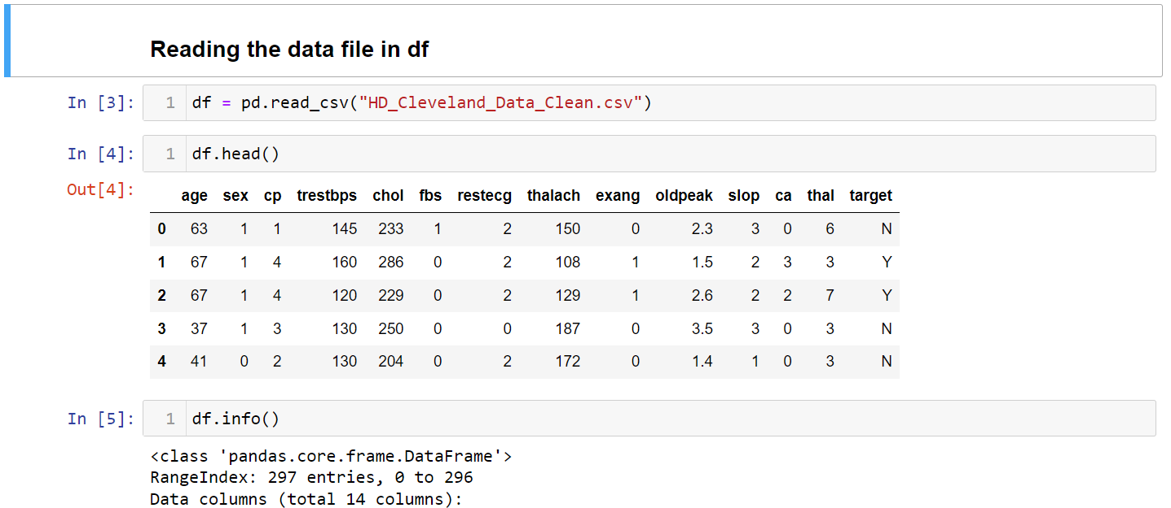
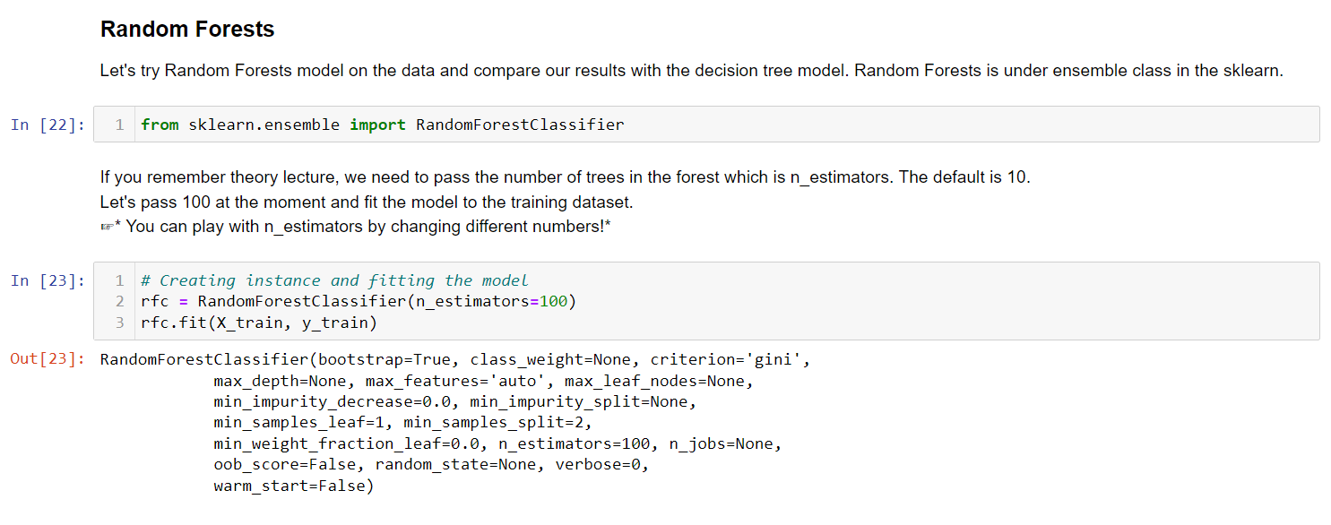
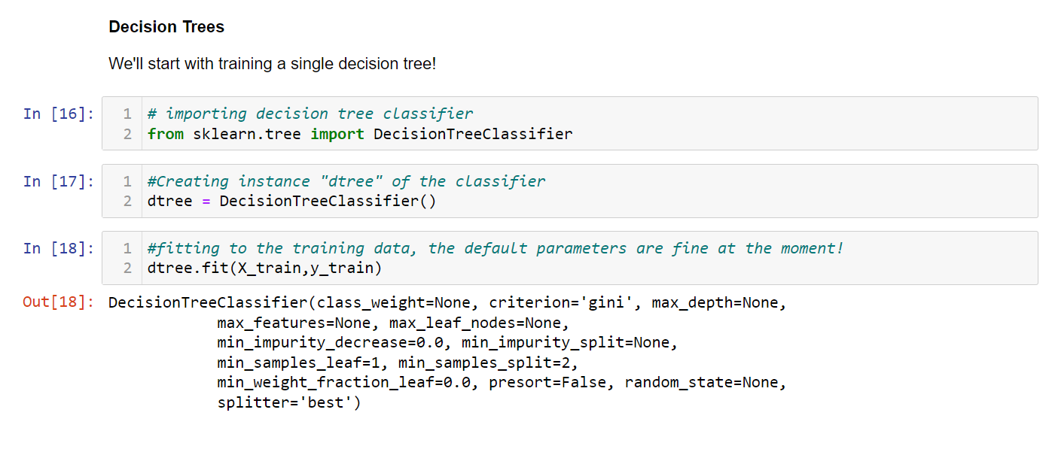
Implimentation
03

Slide 8
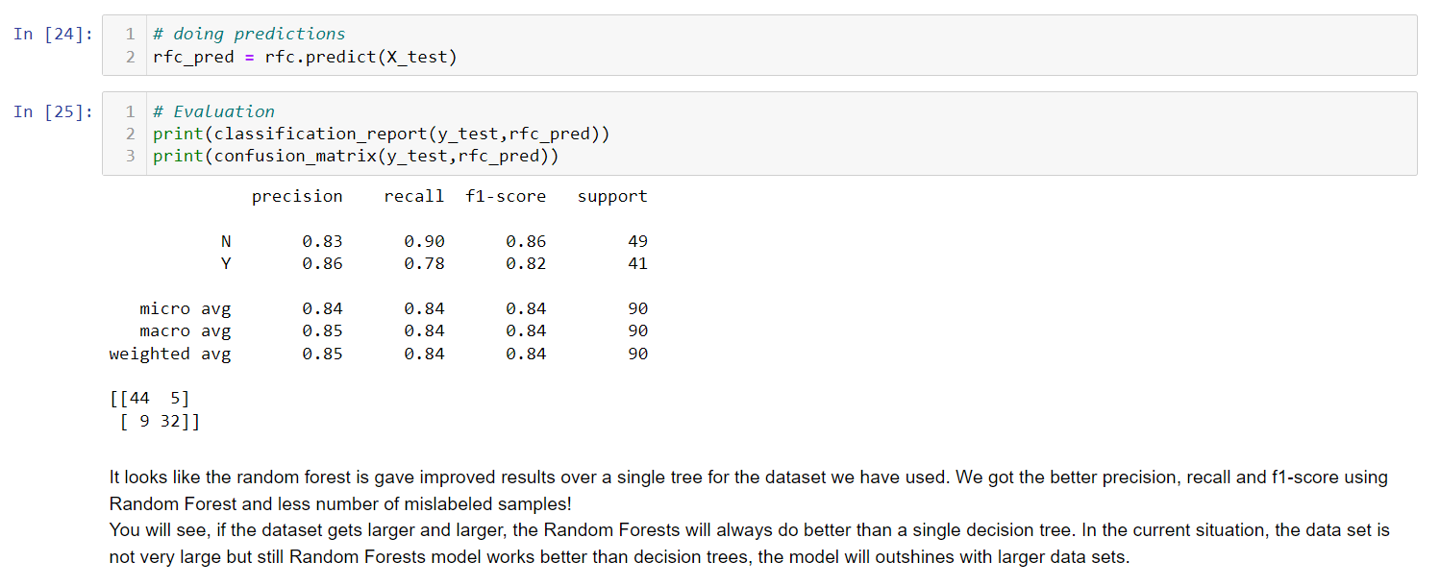
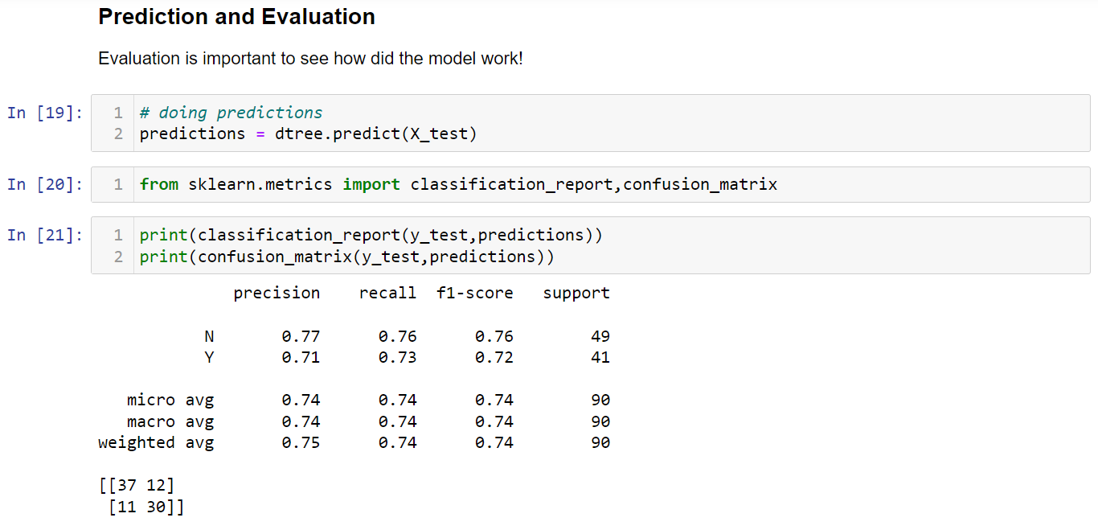
Implimentation
Github URL : https://github.com/Vivek1222/Heart_disease_detection

Slide 9
Conclusion
04
In conclusion, our project successfully developed a machine learning model to predict heart disease risk based on individual health data. By analyzing key factors such as age, sex, blood pressure, and cholesterol levels, our model can accurately identify individuals at risk, enabling early intervention and personalized healthcare. This project highlights the potential of machine learning in improving preventive medicine and enhancing heart disease management.

Slide 10

THANKS!

